Slide 1
CIA Factbook Tableau plots
File created on: 12/22/19 3:41:12 PM PST

Slide 2
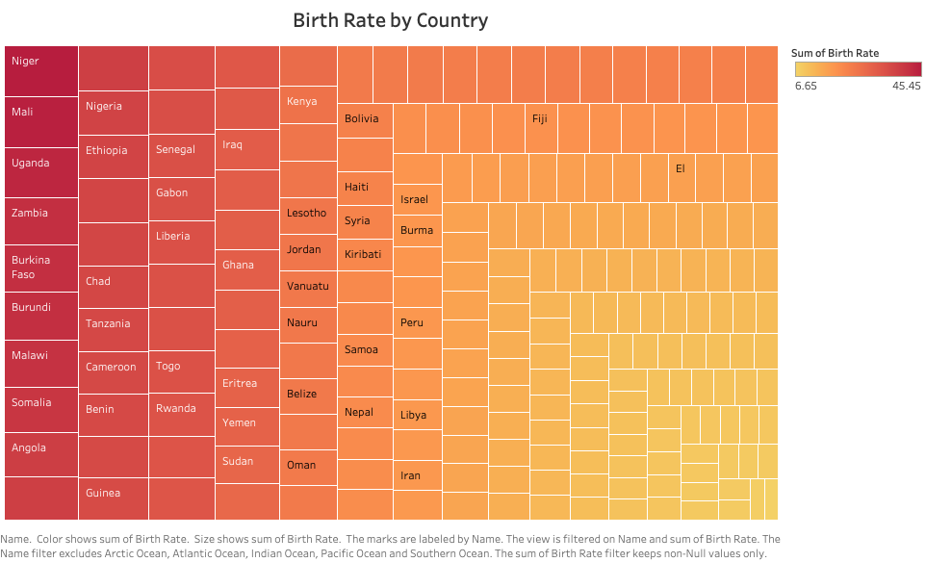

Slide 3
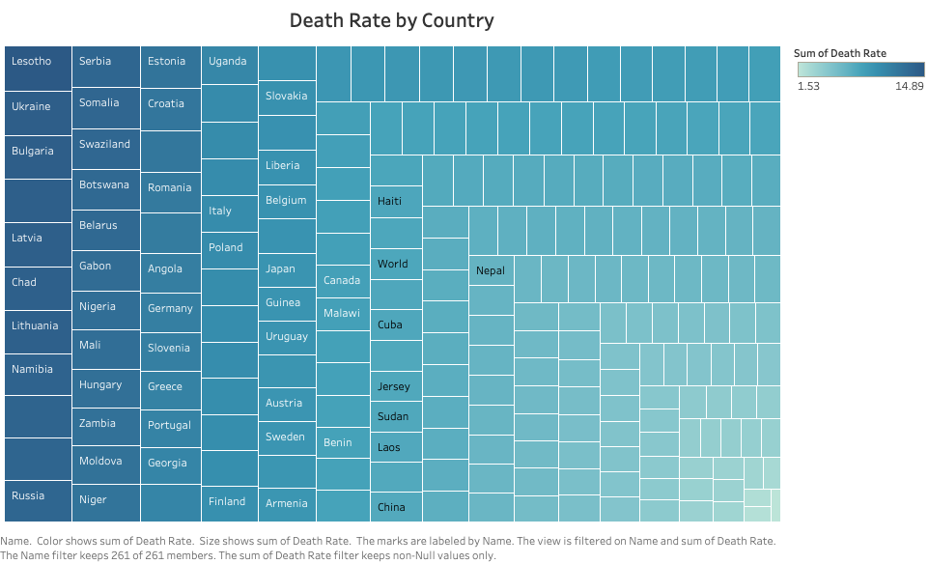

Slide 4


Slide 5
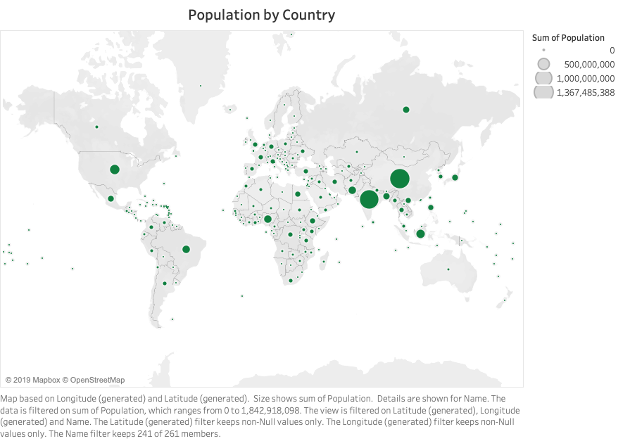

Slide 6


Slide 7


